Slide 1
CSCI 4502/5502
Introduction to Frequent Patterns, Associations, and Correlations

Slide 2
Table of Contents
Market Basket Analysis
Frequent Pattern Analysis
Basic Concepts
Frequent Pattern Analysis Example
Mining Association Rules
Closed Patterns
Max Patterns
Apiori Algorithm
Apiori Pruning
Interestingness Measure
Iterative Nature of Apiori Algorithm
Interestingness Measure in Association Rule Mining
Interview Question
Lesser Known Points
3
4
5
6
7
8
9
10
11
12
13
14
15-17
18-20

Slide 3
Market Basket Analysis
Market Basket Analysis (MBA) identifies groups of items frequently bought together.
Example: Small grocery store transactions reveal milk & bread, and sugar & eggs are commonly bought together.
Key Metrics:
- 'Support' measures frequency an itemset appears in transactions. E.g., Support for {sugar, eggs} is 50%.
- 'Confidence' is the likelihood of item Y being bought when item X is bought. E.g., Confidence for {sugar} -> {eggs} is 100%.
Insights inform decisions like cross-selling, offering discounts, or optimizing store layout.
MBA is a statistical method; correlations don't imply causation.
Algorithms like Apriori and FP-Growth are used for large datasets.
MBA is versatile and can be applied in various domains like website analytics, medical diagnosis, etc.

Slide 4
Frequent Pattern Analysis
Introduction to a core data mining technique focusing on frequent patterns, associations, and correlations.
Frequent Pattern Mining (FPM) identifies sets of items or events that frequently occur together.
Association rules, like 'If bread and butter, then jam', help predict customer behavior. Measures include Support and Confidence.
Correlations describe relationships among data elements. They inform strategic decisions but do not imply causation.
These techniques serve as the backbone for advanced data mining concepts like clustering, classification, and prediction.

Slide 5
Basic Concepts
Frequent Pattern Analysis identifies common sets of items, subsequences, or substructures in data.
Key Terms:
Set of Items: Collection of products in a single transaction.
Subsequences: Sequence of actions or events in a specific order.
Substructures: Complex patterns like subgraphs in graph data.
Applications:
Web Log Data: Analyze sequences of web pages visited before purchase.
Road Traffic Data: Identify busy intersections to manage traffic.
Efficient Algorithms:
Apriori, FP-Growth, PrefixSpan handle large datasets.
Goal: Derive actionable insights by analyzing frequent patterns.
FPA is a powerful tool in data mining across multiple domains.

Slide 6
Frequent Pattern Analysis Example
Study of frequent patterns involves key concepts: frequent itemsets, association rules, support, confidence, minimum support, and minimum confidence.
Frequent Itemset: A collection of items frequently appearing together in a dataset.
Association Rule (X ⇒ Y): If items in set X are bought, items in set Y are likely to be bought too. Does not imply causation.
Support: Frequency of an itemset in the dataset. Expressed as a probability (0 to 1).
Confidence: Likelihood that items in set Y are bought when items in set X are bought. Also between 0 and 1.
Minimum Support and Minimum Confidence: Thresholds to filter out uninteresting rules and focus on statistically significant patterns.

Slide 7
Mining Association Rules
Example dataset: 5 transactions with items A to F. Minimum support and confidence are both 50%.
Frequent Patterns: Sets of items that appear frequently. E.g., A, B, D, E, and AD.
Association Rules (X ⇒ Y): If X is present, Y is likely to be present. E.g., A ⇒ D and D ⇒ A.
Calculating Support:
Count transactions containing both items in the rule.
Divide by total number of transactions.
Calculating Confidence:
Divide support of both items (X ∪ Y) by support of item X.
To determine 'interesting' rules:
Compare calculated support and confidence with minimum support and confidence.

Slide 8
Closed Patterns
Closed Patterns
A Closed Pattern, denoted as XX, is a frequent itemset that has no super-pattern YY (Y⊃XY⊃X) with the same support. In simple terms, if you have a Closed Pattern XX, then you won't find a larger itemset YY that appears in the dataset with the same frequency as XX.
Mathematical Representation: If XX is a closed pattern with support ss, then there doesn't exist a YY such that X⊂YX⊂Y and Support(Y)=sSupport(Y)=s.
Lossless Compression: Closed patterns act as a form of "lossless compression" for frequent patterns. They allow you to capture all the essential information using fewer patterns.
Efficiency: By focusing only on closed patterns, you can reduce the computational burden of processing a large number of patterns without losing any important information.

Slide 9
Max Patterns
Max Patterns
A Max Pattern, denoted as XX, is a frequent itemset that has no super-pattern YY (Y⊃XY⊃X) at all. This means that XX is essentially one of the largest itemsets you can find that is still frequent according to your minimum support threshold.
Mathematical Representation: If XX is a max pattern, then there doesn't exist a YY such that X⊂YX⊂Y and YY is frequent.
Focus on Comprehensive Sets: Max patterns help you concentrate on the 'largest' or 'maximum' patterns in your dataset. These patterns often contain the most comprehensive sets of items that frequently occur together.
Simplicity: Sometimes, you might be more interested in large general trends rather than intricate details, and max patterns can quickly provide this information.

Slide 10
Apiori Algorithm
Apriori Property
The Apriori property is the foundational principle of the algorithm. It states that all non-empty subsets of a frequent itemset must also be frequent. This is based on the intuitive understanding that if, for instance, the itemset {beer, diaper, nuts}is frequent, then its subsets like {beer, diaper}or {beer, nuts} must also be frequent.
Mathematical Representation: If X is a frequent itemset, then all subsets S of X must also be frequent, i.e., S⊆X implies SS is frequent.
Efficiency: Knowing this property allows us to efficiently find larger frequent itemsets. If we find a frequent itemset of size n, we only have to consider its immediate supersets of size n+1 as candidates for being frequent.
Reduction in Search Space: By the same logic, if a set is not frequent, then its supersets cannot be frequent either, which leads us to Apriori pruning

Slide 11
Apiori Pruning
Apriori Pruning is a concept that helps us further reduce the computational load. The basic idea is that if an itemset X is infrequent, then all its supersets must also be infrequent.
Mathematical Representation: If itemset X is infrequent, then for any itemset Y such that X⊆Y, Y is also infrequent. Computational Savings: It helps in reducing the number of itemsets we need to check. If {beer, nuts} is infrequent, we don't have to check {beer, nuts, diaper}, {beer, nuts, soda}, etc.
Focus on Likely Candidates: Pruning allows us to focus our computational resources on the more promising itemsets that have a higher likelihood of being frequent.

Slide 12
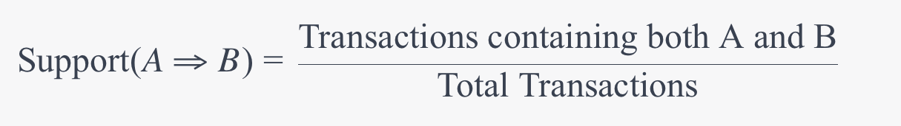
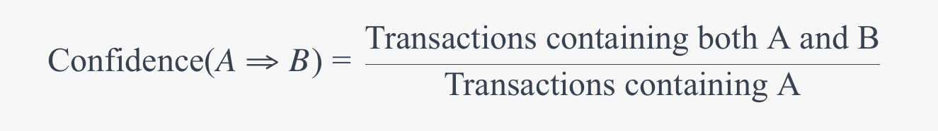
Interestingness Measure
Association Rule Metrics
Support measures how often items AA and BB appear together in the dataset. It's calculated as:
For the rule "play basketball ⇒ eat cereal," the support is 40%, meaning these activities occur together in 40%of all transactions or data points.
Confidence measures the likelihood that item B will appear when item AA appears. It's calculated as:

Slide 13
Iterative Nature of Apriori Algorithm
Key Points:
Focuses on 'itemsets', sets of items occurring together in transactions.
Iteratively builds k-itemsets starting from 1-itemsets that meet a minimum support threshold.
Self-Joining: Generates candidate (k+1)-itemsets from frequent k-itemsets. Joins two k-itemsets if their first (k-1) items are identical.
Pruning: Eliminates any candidate k-itemsets if any (k-1)-itemset subset of it is not frequent.
Example: L3 = {abc, abd, acd, ace, bcd}. Candidate 4-itemsets include abcd, acde. 'acde' is pruned because 'ade' is not in L3.
Applications: Crucial in market basket analysis for discovering product associations.
Impact: Efficiently reduces computational burden, making pattern mining manageable in large data sets.

Slide 14
Interestingness Measure in Association Rule Mining
Measures the worth of an identified association rule (A ⇒ B).
Two main metrics: Support and Confidence.
Example Rule: 'play basketball ⇒ eat cereal', Support: 40%, Confidence: 66.7%.
Caution: Rule may be less informative than it seems. Context matters.
Alternative Rule: 'play basketball ⇒ not eat cereal', Support: 20%, Confidence: 33.3%.
Lift: Another measure to evaluate dependence between A and B.
Other measures like Leverage and Conviction can provide additional insights.
These metrics should not be used in isolation.

Slide 15
Interview Question
Interview Question
You are working as a data scientist for a retail company that wants to better understand its customers' purchasing behaviors. Your company has a rich dataset of transactions, and your task is to provide actionable insights for the marketing team.
Explain how metrics like support, confidence, and lift can be used to identify important association rules in transaction data.
Discuss the concept of "interestingness measures" in the context of association rules. How would you go about determining which rules are the most interesting or valuable to the business?
Describe different data visualization techniques that could be used to present the frequent itemsets and association rules to the marketing team. What are the advantages and disadvantages of each?
What are Closed and Max Patterns, and how can they be useful in analyzing a large dataset of transactions?

Slide 16
Interview Question
Step-by-step Explanation
Part 1: Understanding Metrics
Support: Measures the frequency of an itemset appearing in the dataset. It gives an idea of how prevalent a particular rule is.
Confidence: Measures how often items in BB appear in transactions that contain AA. Confidence gives a sense of the rule's predictive power.
Lift: Measures how much more likely item BB is purchased when item AA is purchased, compared to being purchased randomly. Lift > 1 implies AA and BB are positively correlated.
Part 2: Interestingness Measures
The concept of "interestingness measures" like lift, leverage, or conviction can help us prioritize rules that are more likely to yield actionable insights.
To determine which rules are most valuable, you might consider additional business context or objectives, like profit margins on the items involved, seasonal trends, or stock levels.

Slide 17
Interview Question
Part 3: Data Visualization Techniques
Heatmaps: Useful for identifying hotspots where several variables intersect.
Advantages: Easy to understand
Disadvantages: Limited in the number of variables it can display
Network Graphs: Shows how items are interconnected.
Advantages: Clearly shows relationships
Disadvantages: Can become cluttered
Bar Charts or Pie Charts: Simple and effective but best for displaying single dimensions.
Advantages: Universally understood
Disadvantages: Limited complexity
Part 4: Closed and Max Patterns
Closed Patterns: These are itemsets that have no superset with the same support. They provide a form of lossless compression and are useful for summarizing the data.
Max Patterns: These are itemsets that have no frequent superset. Max Patterns are useful for identifying the most comprehensive itemsets that frequently occur together.

Slide 18
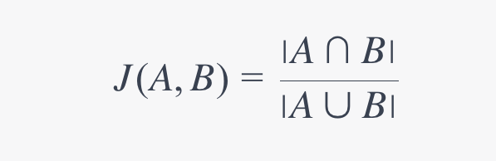
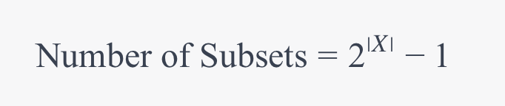
Lesser Known Points
Jaccard Similarity for Quick Scanning: Before diving into complex metrics like support and confidence, one might quickly estimate the similarity between two itemsets A and B using Jaccard Similarity.
Itemset Length and Computation: The length of an itemset ∣X∣ has an exponential relationship with the number of its subsets. Understanding this can give you an intuition about the computational complexity involved.

Slide 19
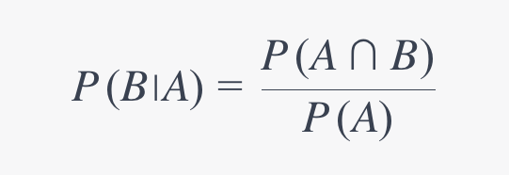
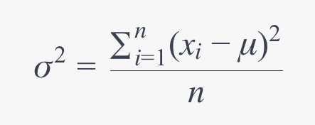
Lesser Known Points
Conditional Probability for Confidence: Confidence is essentially conditional probability in disguise. Understanding the fundamental nature of conditional probability can provide deeper insights into the confidence metric.
Mean and Variance of Support: While not usually computed, understanding that the support of different rules can vary widely may lead you to look into the mean and variance of support values, offering a statistical view of your rules.

Slide 20
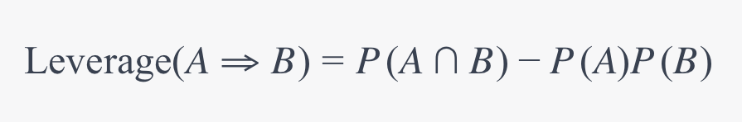
Lesser Known Points
Leverage as a Measure of Independence: Leverage is another interestingness measure, calculated as the difference between the observed frequency of A and B together, and the frequency that would be expected if A and B were statistically independent.

